Slide 1
The Impact of Social Media on a Digital World
Megan Stubbs-Richardson
Assistant Research Professor
Director of Data Sciences for the Social Sciences (DS3) Laboratory
Presented at the Developing the Data Science Ready Workforce of Tomorrow: Workforce Development and Higher Education in the Context of Digital Transformation on August 2, 2022

Slide 2
Background
Social Scientist interested in Data Science
Conducted research on digital media data since 2012: beginning with Twitter data
Open-source intelligence research using Babel Street (60 + platforms with language translation capabilities)
NSF Rapid project (2020 – current) - collecting data through Application Programming Interfaces (APIs) for 10 platforms
Applied a variety of methodological approaches to digital data over time

Slide 3
Background
Director of Data Science for the Social Sciences Laboratory
About us: https://ds3.ssrc.msstate.edu/
  Interdisciplinary collaborative
  Faculty, Staff, Students
  Meet bi-weekly to work on projects
    Analyzing Covid-19 content across 10 social media and forums platforms
    Examining attitudes toward law enforcement using sentiment analyses
    Analyzing various aspects of the MeToo movement

Slide 4
The Need for a Data Science Workforce
There exists a need for teams of professionals with a variety of skills at various levels
There is a need to move away from the overloading of the term “data scientist” toward teams of data science professionals (Saltz & Grady, 2017).
Big data systems: data provider - > data collectors: prepare, analyze, visualize, management, security and privacy, to providing access to data consumers (Saltz & Grady, 2017).

Slide 5
The Need for a Data Science Workforce in Digital Data
Vast amount of data with social media posts and forums often being qualitative in nature
Need humans to interpret the meaning that machines often miss
Various interdisciplinary levels of skills are needed

Slide 6
The Need for Examining Digital Data
89% of United States (U.S.) adults reported using the Internet (Pew Research Center 2018).
U.S. Internet users tended to be college educated, between the ages of 18 and 49 and had an annual income over $30,000.
Individuals in urban and suburban areas were more likely to be Internet users (Pew Research Center 2018).
U.S. rates of Internet usage are similar for White, Black, and Hispanic men and women (Pew Research Center 2018).
However, demographics vary widely when it comes to social media usage (Auxier & Anderson, 2021).

Slide 7
The Need for Examining Digital Data
Search engine optimization and increased Internet access has led to the pervasiveness of online searches for information acquisition.
According to Purcell et al. (2012), 91% of all online adults use search engines. Of those using search engines, roughly 83% rely on Google (Purcell et al. 2012).

Slide 8
The Need for Examining Digital Data
Social media use has increased faster than pre-pandemic, with a reach globally of almost 13 ½ new users every second (Datareportal, 2022; Kepios, 2022).
There are 4.70 billion active social media users world-wide (Datareportal, 2022; Kepios, 2022).
Internet users aged 16 to 64 spend 2 hours and 27 minutes on social media on average per day (Datareportal, 2022; Kepios, 2022).

Slide 9
The Need for Examining Digital Data
The top five reasons reported for using the Internet (Datareportal, 2022; Kepios, 2022):
  Finding information
  Staying in touch with friends and family
  Keeping up to date with news and events
  Watching videos, TV shows, and movies
  Researching how to do things

Slide 10
The Need for Examining Digital Data
U.S. Social Media use:
81% of U.S. adults use YouTube, 69% use Facebook, 40% use Instagram, 31% use Pinterest, 28% use Linkedin, 25% use Snapchat, 23% use Twitter, 23% use WhatsApp, 21% use TikTok, 18% use Reddit, and 13% use Nextdoor (Anderson & Jiang, 2018).
85% of U.S. teens aged 13-17 use YouTube, 72% use Instagram, 69% use Snapchat, 51% use Facebook, 32% use Twitter, 9% use Tumblr, and 7% use Reddit (Auxier & Anderson, 2021).

Slide 11
The Need for Examining Digital Data
Interpersonal communication is not an isolated action.
  It is impacted by the type of platform used, the information exchanged, what communication occurs, and how it is shared.
  Social media has changed the nature of our relationships and social institutions (Butler & Matook, 2015):
    Family, friends, co-workers, classmates, strangers
    Family, Work, Education, Healthcare, etc.

Slide 12
The Need for Examining Digital Data
Overcomes barriers of former relationship development (e.g., proximity)
New relationships bridge geographic, political, and social boundaries and are a significant driver of social media’s transformative impact on organizations and society (Butler & Matook, 2015).
Just like offline, there is an array of prosocial and antisocial behavior online.

Slide 13
The Need for Examining Digital Data
Prosocial Behavior – behavior with the intention of benefiting other people
  Helping (e.g., providing support to victims)
  Sharing
  Donating (e.g., GoFundMe)
  Co-operating
  Volunteering
  (e.g., Hurricane Sandy)

Slide 14
The Need for Examining Digital Data
Antisocial Behavior – disruptive acts by covert or overt hostility or aggression towards others (and sometimes property of others)
  Cyberbullying, victim blaming, hate speech
  Computer crimes (e.g., theft)
  Stalking
  Organized crime (e.g., terrorism)
  Illicit supply networks

Slide 15
The Need for Examining Digital Data
In addition to our connection to people, our connection to technology is also changing:
The Internet enables social technology for knowledge consumption and production (Hartley, 2011).
Increased internet access, Google, YouTube, Siri: Access to new skills/learning resources, DIY projects, recipes,
  Smart phones, tablets have increased Internet access

Slide 16
The Need for Examining Digital Data
We can quickly access new information and learn quite a bit online.
“With YouTube in mind… the internet has rapidly evolved into a new ‘enabling social technology for knowledge’ (Dezuanni, 2021; Hartley, 2011).”
But… this access to knowledge is not without misinformation (Wong et al., 2021).
  Rush to publish new content
  Anyone can post new content
  No peer review process

Slide 17
The Need for Examining Digital Data
All of this human behavior and human to machine interaction is DIGITAL!
There are tools to collect it!
There are tools to analyze it!
And, we need TEAMS of people with various skills to analyze the VAST amount of data!

Slide 18
The Need for Examining Digital Data
The skills needed in data science involve making sense of vast amounts of largely qualitative data (i.e., content of posts).
  Literature Reviews
  Developing codebooks
  Automated computational coding
  Hand labeling data for training machine learning models
  Flagging illicit content to report to law enforcement or other agencies

Slide 19
The Need for Examining Digital Data
The Scientific Method
The Technical Aspects
Research Studies as examples

Slide 20
How should I begin conducting research online?
The Science Side: The Scientific Method
  Select a topic of interest
  Identify a research question
  Conduct a literature review
  Refine your research question
  Conceptualization and operationalization of variables
  Study design: Quantitative/Qualitative
  Develop a research codebook
  Code the data using the codebook and calculate inter-rater reliability to assess agreement

Slide 21
How should I begin conducting research online?
The Technical Side: Data collection
Three options:
  Application Programming Interface
  Web scraping
  Manual searches using single terms or phrases at a time

Slide 22
Example projects and research questions
Rape Culture Project
How is rape culture perpetuated on Twitter? Are victim blame/support tweets more influential?
Google Property Crime Project
Are crime prevention queries correlated with crime and crime reduction at the state level?
Islamic State (IS) Magazines Project*
How are IS magazines discussed online?
Which platforms host the content the most?

Slide 23
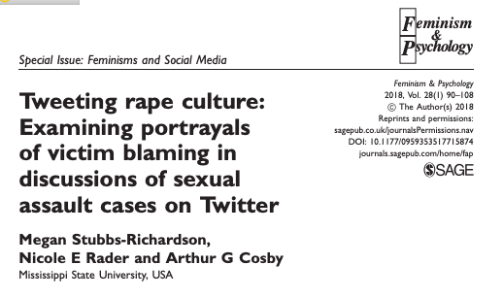
Notes:
Three themes were identified: 1) the virgin-whore binary and the just world 2) sub-tweeting, and 3) rape myth debunking
Victim blame tweets were more influential then victim support

Slide 24
Tweeting rape culture study
Methods: Twitter data collected through the Social Media Tracking and Analysis System (SMTAS); Content Analysis; Analysis of Meta-data
Results:
  Three themes were found: 1) Pro-victim - rape myth debunking, 2) Victim blame– rape myth supporting, and 3) sharing news about sexual assault cases.
  Victim blaming tweets were more influential than victim supporting tweets (Stubbs-Richardson, Rader, & Cosby, 2018).

Slide 25
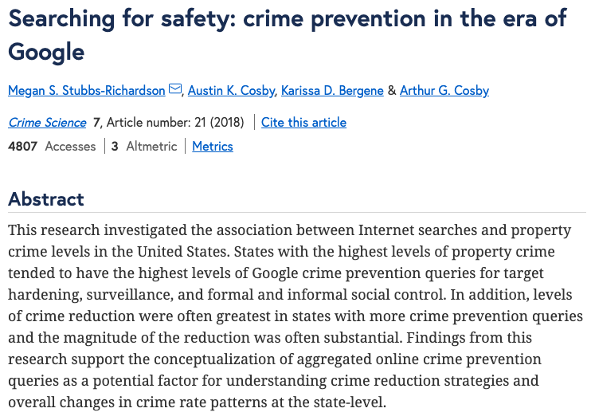
Notes:
Moderate to strong correlates between property crime and crime prevention search terms
86% of the correlations were significant; 58% were significantly correlated with crime reduction
Strongest keyword searches were for the surveillance category (e.g., home/car alarm systems)

Slide 26
Searching for safety study
Methods: Google Correlate Data; Uniform Crime Report Data; Aggregated search terms related to crime prevention; ANOVA
Results:
  Moderate to strong correlates between property crime and crime prevention search terms
  86% of the correlations were significant; 58% were significantly correlated with crime reduction
  Strongest keyword searches were for the surveillance category (e.g., home/car alarm systems; Stubbs-Richardson, Cosby, Bergene, & Cosby, 2018).

Slide 27
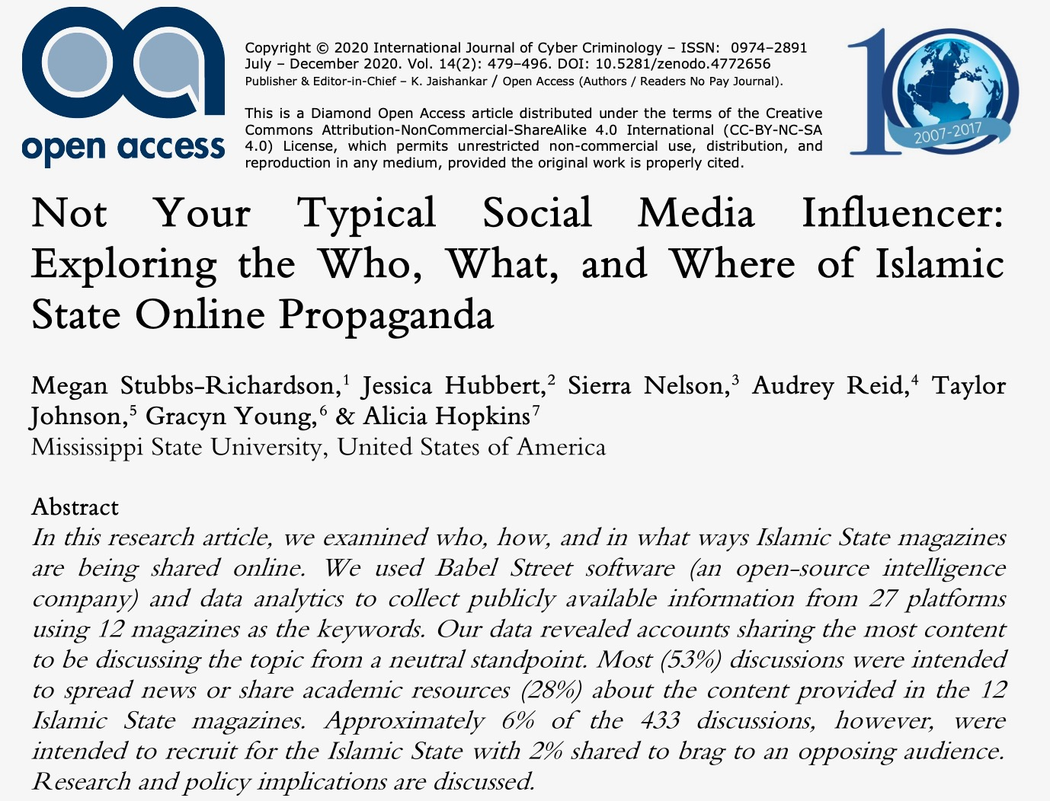

Slide 28
Islamic State propaganda study
Methods: Babel Street data (27 relevant sources, language translation 100 + languages); Content analysis (yes or no); Automated coding procedures; filtering out and reporting illicit content to authorities
Results:
  While most sources were news related (53%) or for academic purposes (28%), 6% were intended to recruit for the Islamic State (IS) while 2% of posts bragged about IS accomplishments to opposing audiences; Stubbs-Richardson et al., 2020).
  Top three places: Blogs (32%), Facebook (18%), and LinkedIn (18%) with other stats ranging from 0.2 to 6.9% for other platforms.

Slide 29
NSF Rapid Project
Covid-19 Online Prevalence of Emotions in Institutions Database (Richardson, Anreddy, & Porter, 2020).
For information about the COPE-ID Database: https://copeid.ssrc.msstate.edu/
Data sources: Twitter, Gab, Tumblr, Flickr, 4chan, 8kun, Mastodon, Parler, Reddit, and YouTube.

Slide 30
NSF Rapid Project
Keywords: Covid-19; sars-cov-2, corona, corona virus, coronavirus, coronaviruses, social distancing, quarantine, covid19, pandemic, virus, #socialdistancing
Dates: January 2020 – April 2021
Research Areas:
  Misinformation and counter misinformation*
  Machine learning models of misinformation across platforms
  Emotion detection
  Emotions linked to health prevention regulations

Slide 31
Importance of developing a codebook
Developing a codebook to make sense of a variety of posts
  Literature reviews
  Qualitative analyses of the data
Creating definitions for variables of interest
Establishing exclusion and inclusion criteria
Meeting regularly to discuss codes
Refining the codebook
Following the links for full contextual clues prior to labeling the data

Slide 32
Example codebook
G_MISINFO (General Misinformation on COVID-19) is false or inaccurate information that is deliberately created and is intentionally or unintentionally propagated on COVID-19. For example, the document may use hashtags such as #CovidHoax, #Plandemic, #FauciFraud, and #DePopulation.
*As connected to the #Depopulation hashtags, such arguments falling in this category believe for example that Bill Gates created Covid in a secret lab. Some also believe he created the vaccine for depopulation which would fall under the vaccine misinformation category.
*Note, a post can include both general misinformation and vaccine misinformation. It can be classified as both categories (1 = yes) when the definitions apply in both cases.
  Is the document about GENERAL COVID-19 MISINFORMATION? 1 = YES, 2 = MAYBE, 3 = NO

Slide 33
Example codebook
GC_MISINFO (General Counter of Misinformation on COVID-19) is generally countering misinformation by offering facts or sharing personal experiences in attempt to correct misinformation related to COVID-19. Note, true factual statements are not enough to classify the document as countering general misinformation. The post must clearly seem to be intended for that purpose, such as replying to another person to correct misinformation.
Is the document about COUNTERING GENERAL COVID-19 MISINFORMATION? 1 = YES, 2 = MAYBE, 3 = NO

Slide 34
Example codebook
V_MISINFO (Misinformation on COVID-19 vaccines) is false or inaccurate information that is deliberately created and is intentionally or unintentionally propagated about the COVID-19 vaccine.
*If you see the hashtag, #nocovidvaccine but the document has no additional text/hashtags to indicate why they do not want the vaccine, this is not enough information to code it as misinformation.
*If the hashtag, #nocovidvaccine is connected to depopulation/ population control or #Depopulation #PopulationControl type arguments/hashtags, then it can be coded as vaccine misinformation. The depopulation argument is misinformation that has been flagged by agencies and is tied to both Covid-19 generally and the Covid-19 vaccine. For example, some believe it is Bill Gates plan to depopulate the world through forced vaccination.
*Note, a post can include both general misinformation and vaccine misinformation. It can be classified as both categories (1 = yes) when the definitions apply in both cases.
Is the document about VACCINE MISINFORMATION? 1 = YES, 2 = MAYBE, 3 = NO

Slide 35
Example codebook
VC_MISINFO (Vaccine Counter of Misinformation on COVID-19 vaccine) is countering specific misinformation by offering facts or sharing personal experiences in attempt to correct misinformation related to COVID-19 vaccines.
* Note, true factual statements are not enough to classify the document as countering vaccine related misinformation. The post must clearly seem to be intended for that purpose, such as replying to another person to correct misinformation surrounding the vaccine or sharing one’s personal experience with the vaccine in a way that seems intended to reduce more widespread fear or misinformation connected to vaccination.
Is the document about a COUNTERING COVID-19 VACCINE MISINFORMATION? 1 = YES, 2 = MAYBE, 3 = NO

Slide 36
Example codebook
G_CYBERCRIME (General Cybercrime related to COVID-19) is the larger category that includes the subcategories: SCAMS and FRAUD. This could come from the perspective of offenders, victims, or society and for instance may include warnings about scams related to COVID-19.
Is the document about GENERAL COVID-19 CYBERCRIME? 1 = YES, 2 = MAYBE, 3 = NO
*Cybercrime includes SCAM and or FRAUD. To be labeled CYBERCRIME, the code must either fit the SCAM or FRAUD definitions below.

Slide 37
Example codebook
V_CYBERCRIME (Cybercrime related to COVID-19 vaccines) is the larger category that includes the subcategories: SCAMS and FRAUD. This could come from the perspective of offenders, victims, or society and for instance may include warnings about scams related to vaccines.
Is the document about COVID-19 VACCINE CYBERCRIME? 1 = YES, 2 = MAYBE, 3 = NO
SCAMS usually include an attempt to manipulate or mislead another person for financial gain. For example, this may entail offering something false (e.g., fake vaccines, fake cures of COVID-19) or lead to fake government websites.
FRAUD occurs when individuals or organizations claim untrue elements about an event or topic (e.g., COVID-19 vaccinations) that is believed by victims who act upon the false information and usually suffers the loss of money or property as a result.

Slide 38
Analyses of Digital Data
Once you have classified the posts, you can conduct a variety of analyses of the data:
  Inter-rater reliability
  Qualitative and Quantitative analysis
  Analyses of Meta-Data – Data of the Data - @ mentions, re-posts/shares to assess influence/spread of the content
  Content analysis
  Spatial analysis
  Network analysis
  Automated coding
  Machine learning
  Topic modeling

Slide 39
References
Anderson, M., & Jiang, J. (2018, November 28). Teens’ Social Media Habits and Experiences. Pew Research Center: Internet, Science & Tech.
Auxier, B., & Anderson, M. (2021, April 7). Social Media Use in 2021. Pew Research Center: Internet, Science & Tech. https://www.pewresearch.org/internet/2021/04/07/social-media-use-in-2021/
Butler, B. S., & Matook, S. (2015). Social media and relationships. The international encyclopedia of digital communication and society, 1-12.
Datareportal. (2022). Digital 2022 July Global Statshot Report. https://datareportal.com/global-digital-overview

Slide 40
References
Dezuanni, M. L. (2021). TIKTOK’S PEER PEDAGOGIES - LEARNING ABOUT BOOKS THROUGH #BOOKTOK VIDEOS. AoIR Selected Papers of Internet Research. https://doi.org/10.5210/spir.v2021i0.11901
Hartley, J. (2011). The Uses of Digital Literacy (Vol. 40). SAGE Publications Inc. https://doi.org/10.1177/0094306110396849e
Kepios. (2022). Digital 2022 Global Overview Report: The Essential Guide To The World’s Connected Behaviors. https://kepios.com/reports

Slide 41
References
Pew Research Center. (2018, February 5). Internet/Broadband Fact Sheet. Retrieved from http://www.pewin terne t.org/fact-sheet /inter net-broadband/#. Accessed August 1, 2022.
Purcell, K., Brenner, J., & Rainie, L. (2012, March 9). Search engine use 2012. Retrieved from http://www.pewin terne t.org/2012/03/09/searc h-engine-use-2012/. Accessed August 1, 2022.
Richardson, M., Anreddy, S. R., & Porter, B. (2020)., “RAPID: Analyses of Emotions Expressed in Social Media and Forums During the COVID-19 Pandemic,” National Science Foundation, Award Abstract #2031246, https://www.nsf.gov/awardsearch/

Slide 42
References
Saltz, J. S., & Grady, N. W. (2017, December). The ambiguity of data science team roles and the need for a data science workforce framework. In 2017 IEEE international conference on big data (Big Data) (pp. 2355-2361). IEEE.
Stubbs-Richardson, M. S., Cosby, A. K., Bergene, K. D., & Cosby, A. G. (2018). Searching for safety: crime prevention in the era of Google. Crime Science, 7(1), 1-13.
Stubbs-Richardson, M., Hubbert, J., Nelson, S., Reid, A., Johnson, T., Young, G., & Hopkins, A. (2020). Not Your Typical Social Media Influencer: Exploring the Who, What, and Where of Islamic State Online Propaganda. International Journal of Cyber Criminology, 14(2), 479-496.

Slide 43
References
Stubbs-Richardson, M., Rader, N. E., & Cosby, A. G. (2018). Tweeting rape culture: Examining portrayals of victim blaming in discussions of sexual assault cases on Twitter. Feminism & Psychology, 28(1), 90-108.
Wong, A., Ho, S., Olusanya, O., Antonini, M. V., & Lyness, D. (2021). The use of social media and online communications in times of pandemic COVID-19. Journal of the Intensive Care Society, 22(3), 255–260. https://doi.org/10.1177/1751143720966280

Slide 44
Questions?
Megan Stubbs-Richardson
megan@ssrc.msstate.edu

