Slide 1
Rethinking the Sports, Industrial, and Military Athlete in a Digital Age
Presented to Developing the Data Science Ready Workforce of Tomorrow by: Reuben Burch (on behalf of the AE Team)
8/2/2022

Slide 2
Background of Reuben Burch
Academic history:
Bachelors in Computer Engineering
Mississippi State University
1997-2002
Masters in Industrial & Manufacturing Systems Engineering
Kansas State University
2008-2010
Doctorate in Industrial & Systems Engineering
Mississippi State University
2011-2014
Professional history:
Virtual reality hardware and software research and development
NASA satellite systems, Naval weapons systems, and other DoD and DoE large project work
Software Configuration Management for all claims/insurance financial infrastructure
Enterprise architecture and standards development work
Research, development, and understanding of:
Mobile handheld and wearable technology development
Human workforce and demographic shift
Robotics and autonomous vehicle development
Academic and vendor partnerships
Potential intellectual property design

Slide 3
20 Years of R&D Experience in Industry, Military, and Sports
Use of Data Science in R&D before Academia:
Data Visualization & Presentation (atmospheric; satellite trajectory; tactical weapons, & radar)
Operations-related Data Analytics (logistics)
Sector-Specific Data Analytics (generational cohort; rugged mobile computing; autonomous vehicle retrofitting)
Data Engineering & Data Warehousing (satellite imagery; medical claims)
Use of Data Science in R&D since Academia:
Data Visualization & Presentation (sports performance; wearable device output)
ML / Cognitive Computing Development (human performance neural network training)
Most Important Data Science Skills (to me):
Understanding of Data Context
Multilingual Communication with Stakeholders
Developing Consistent Data Collecting Methodologies (standardization of validation)
Incremental R&D
Small “r”, big “D”
Small advances in technology and minimal innovation
1-2 year plan
Radical R&D
Big “R”, big “D”
New knowledge discovery and application for a useful business purpose
2-5 year plan
Development
Standard Use
Small “r”, small “d”
Status quo, in use today
Fundamental R&D
Big “R”, small “d”
Scientific and technological reach into the unknown
5-10 year plan and beyond
Research

Slide 4
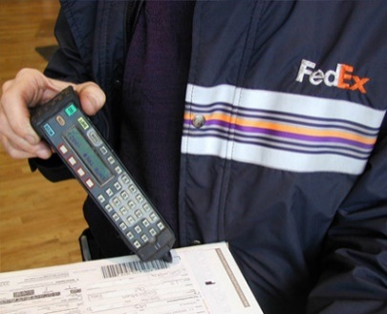
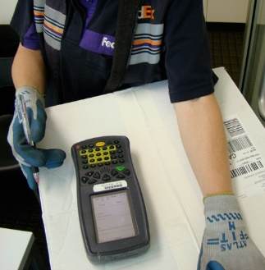
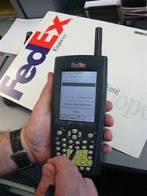
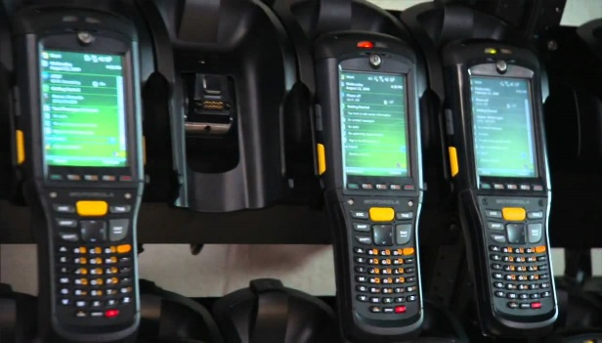
Ruggedized Handheld Evolution at FedEx
A
B
C
D

Slide 5
Brick Form Factor Ruggedized Handheld Devices
U.S. Domestic Courier PowerPad
Non-U.S. Region Courier PowerPad

Slide 6
Four Generations of Human Factors/Ergonomics
 | Equipment Adaptation | Description | Generational Current State
Generation 1 | Physical fit | Adapt equipment, workplace, and tasks to human capabilities and limits | Mature
Generation 2 | Cognitive fit | Harmoniously integrate humans, technology, and work to enable effective systems | Growth
Generation 3 | Neural fit | Amplify human physical and cognitive capabilities to perform work through symbiotic coupling with technology | Emerging
Generation 4 | Biological fit | Biologically modify physical and/or cognitive capabilities to maximize human effectiveness | Embryonic
Gen 1: Physical Fit – Mid-1980’s and older; no longer valid
Gen 2
Gen 2.5
Gen 2
Incremental R&D
Radical R&D
Gen 2: Cognitive Fit – Most industrial tools from 1990’s through 2020
Development
Gen 2.5: Awareness Fit – Blend consumer experience with industrial tool
Gen 2
Gen 3
Standard Use
Fundamental R&D
Gen 3: Neural Fit – Tools that blur where the human ends and the tool begins
?
Gen 4: Biological Fit – Redesign the human worker, not the tool
Research
Notes:
Four generations of human factors / ergonomics as defined by Boff back in 2006 and how we describe the evolution and prediction of the future technology
So how is a doctorate useful in industry? Even in small amounts that are used to further innovations!

Slide 7
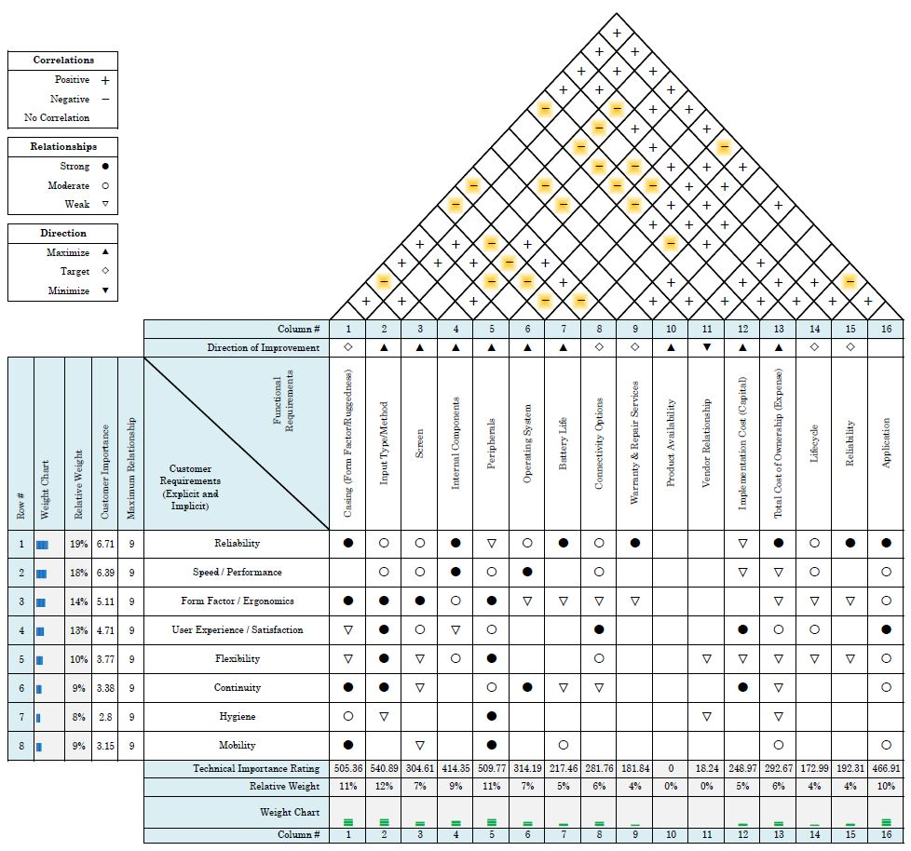
Predicting Future Device Concerns
Five most echoed complaints about current PowerPad hardware:
Alphabetically ordered keys
Shift function; numbers share keys
Device weight
Screen scratches too easily (even with protector)
Holster not ideal for sitting in van
Casing (form factor, ruggedness)
Input type/method
Peripherals
Notes:
Multiple tools in the QDM tool belt were used to identify how we can improve our device selection and global deployment process
This QFD (House of Quality) diagram was built using both engineering and VOC (Voice of Customer) requirements and was weighted based on a field survey used to determine the most important end user requirements in order of rank preference (8 being the most necessary and 1 being the least)
The results show that the three highest technology importance ratings (form factor/ruggedization, input type/method, and peripherals) directly correlate to the top five issues the field has with the current PowerPad
This small study shows how QDM could be used to mitigate potential issues that the field might experience with a new piece of technology and may be a great tool to incorporate into future RFP scoring methodologies

Slide 8
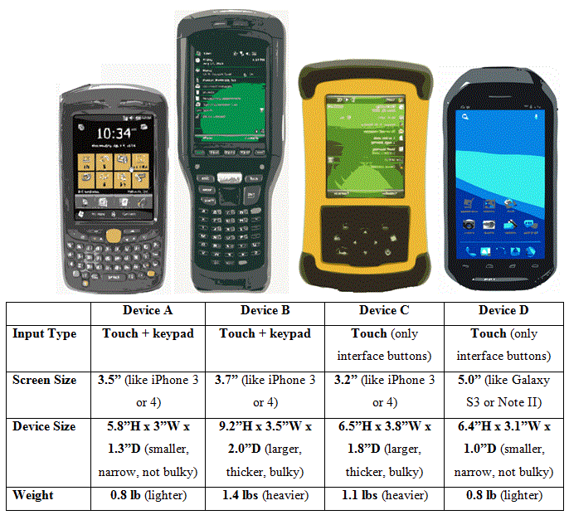
Domestic Field Device Preference (Qualitative)
Rugged Handheld Components | Generation 2.0 | Generation 2.5
Outer Shell | Larger casing; one hand hold and another for entry | Smaller casing; one hand hold and data entry
Keypad | Physical keypad | Touchscreen only
Display | Smaller screen size | Larger screen size
Internal Components | Larger components; heavier device | Smaller components; lighter device
Accessories | Only use device for job function; no peripherals | Incorporate peripherals
Experience rugged device users preferred:
Smaller casing (Gen 2.5)
Physical keys (Gen 2.0)
Larger display (Gen 2.5)
Smaller components; lighter device (Gen 2.5)
Peripherals (Gen 2.5)
Significant difference in preference for Device D* by all generations
z(403) = -2.46, p = 0.014
Significant difference in preference for Device D* over Device B
z(403) = -9.49, p < 0.001
*Alpha (α) value = 0.05
Notes:
When using a survey to compile information it’s common to change your alpha value to .1 which means that a 90% degree of confidence is acceptable to state given the variation that comes with survey participants.

Slide 9
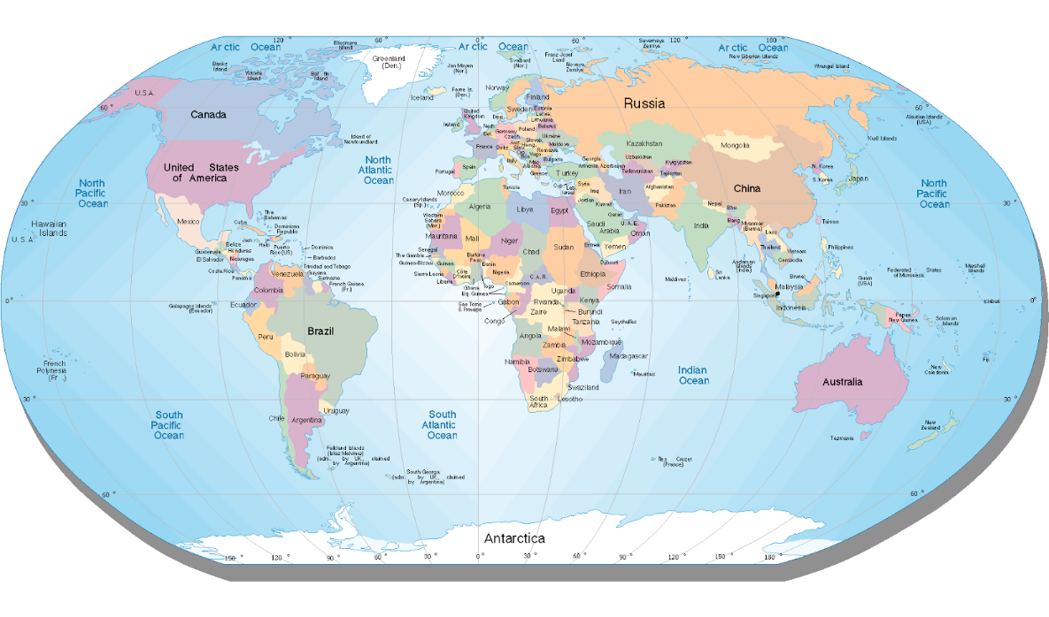
International Regions & Preference
Key Findings Include:
All regions combined mirrored the U.S.-only preferences:
Device D: 44.32%
Device A: 36.21%
Device B: 13.83%
Device C: 5.64%
Canada
Europe
B
A
C
D
Asia
Latin
America &
the Caribbean
Middle East &
Africa
Australia
Device | Percentage of device preference by region
 | Asia | Australia | Canada | Europe | Latin America | Middle East | USA
A | 35.31 | 36.58 | 39.70 | 31.82 | 40.7 | 66.67 | 35.47
B | 10.31 | 26.83 | 11.45 | 21.82 | 13.95 | 11.11 | 14.53
C | 4.12 | 7.32 | 3.05 | 6.36 | 8.14 | 0 | 7.14
D | 50.26 | 29.27 | 45.80 | 40 | 37.21 | 22.22 | 42.86

Slide 10
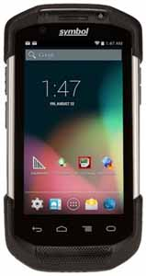
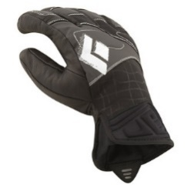
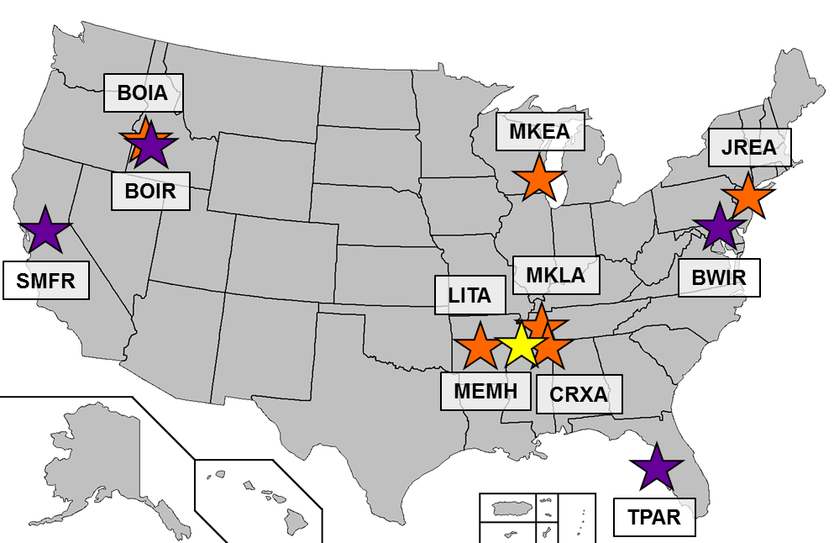
Domestic Handheld Field Studies (Quantitative)
Physical keypad input VERSUS touchscreen only input
Baby Boomer output VERSUS Gamer output
Statistical analysis of measurement of both speed and accuracy
Rugged devices only and experienced rugged users only
Motorola TC75
(4.7” display)
Honeywell CT50
(4.7” display)
20 Gamers and 20 Boomers were selected from 6 Stations, 4 Ramps, and 1 Hub
23 Couriers, 10 Ramp Agents, and 7 Handlers
34 Men and 6 Women
Notes:
Why do this test now?
Upcoming U.S. Domestic PowerPad RFP scheduled for May 2015
Never been done before
Technology now meets need (Glove touch technology)
User experience (UX) VERSUS worker expectation
U.S. Domestic employees in the field 74% male, 26% female for all front line workers and managers
For field management, breakdown is 79% male, 21% female
FXE costs for study:
Equipment: $360
Travel: $1183
Total: $1543

Slide 11
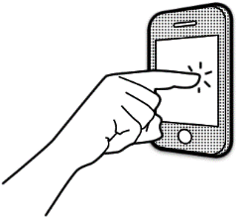
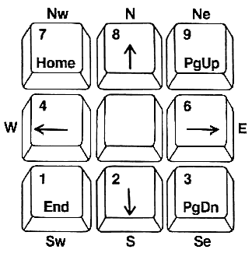
Field User Effectiveness: Time & Error Results
Time:
All users took significantly less time* on touchscreen by 19%
t(39) = 4.77, p < .001
Gamers took significantly less time* than Boomers on all devices:
31% on physical keypad: F(1, 38) = 47.16, p < .001
28% on touchscreen: F(1, 38) = 17.27, p < .001
Errors:
No significant difference* by generation for key errors
F(1, 38) = 0.10, p = .759
No significant difference* by generation for touch errors
F(1, 38) = 3.09, p = .087
Gamers had an 83% increase in permanent errors: t(19) = -1.93, p = .069
Four error categories observed: insertion, omission, substitution, and sequence
Substitution errors committed 64.4% of the time
TOUCHSCREEN
KEYPAD
*Alpha (α) value = 0.05

Slide 12
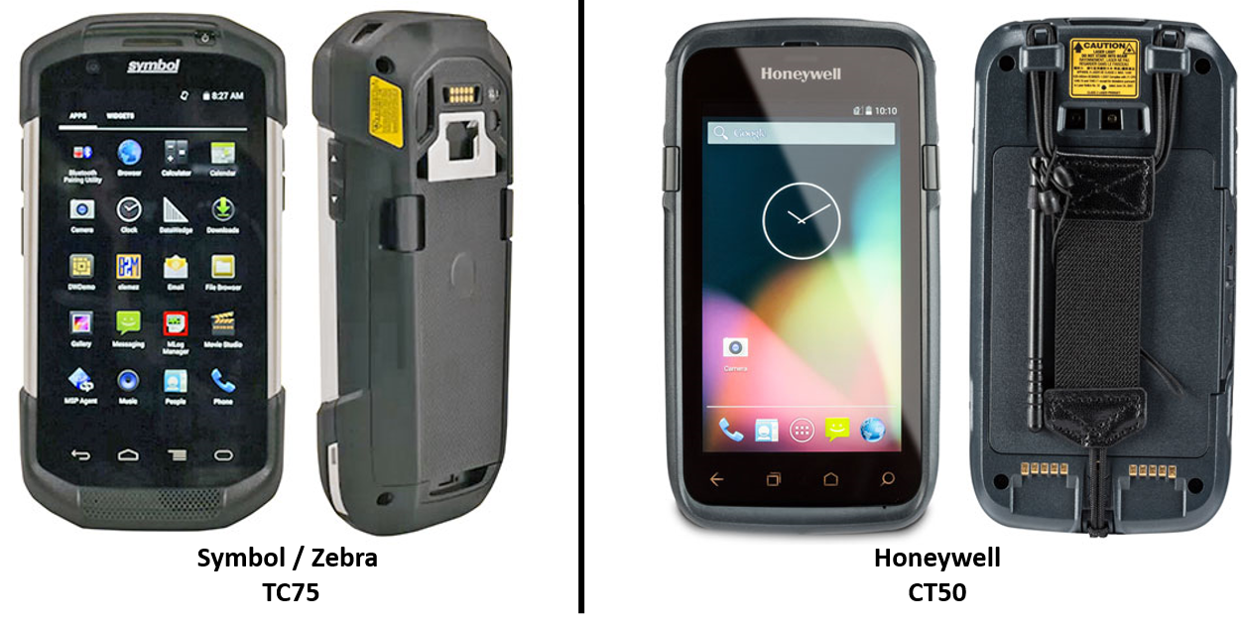
Cookie Sheet Form Factor Ruggedized Handheld Devices
Options for U.S. & Non-U.S. Courier PowerPad

Slide 13
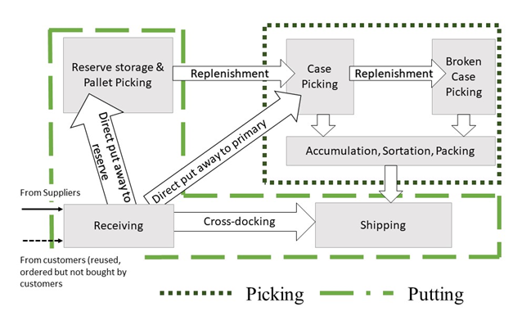
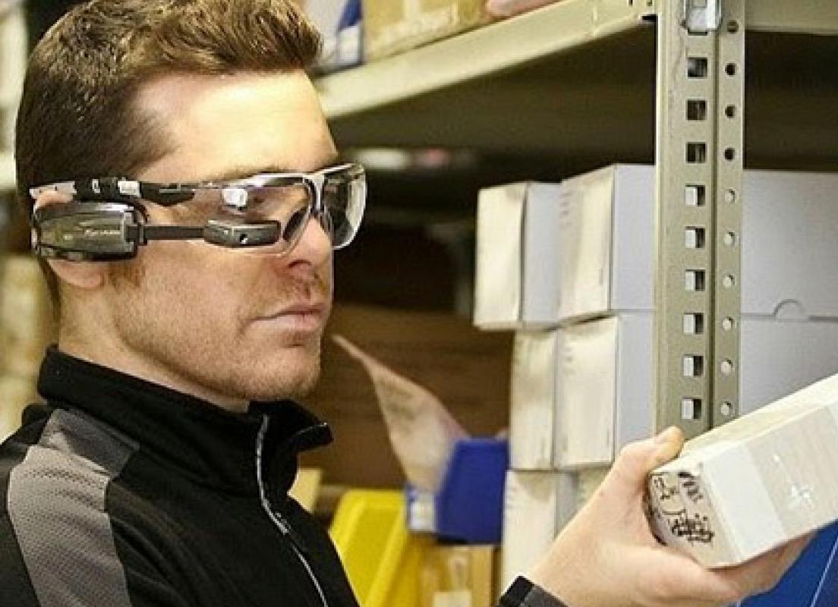
Work Performing Wearables (Human Factors 3.0)

Slide 14
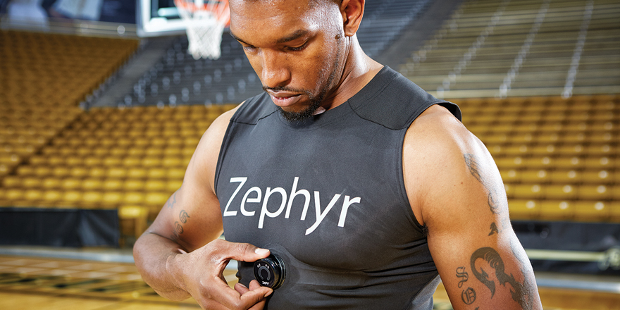
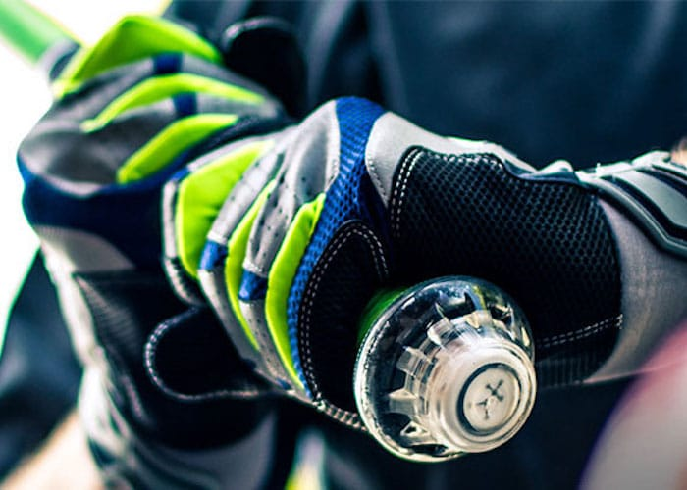
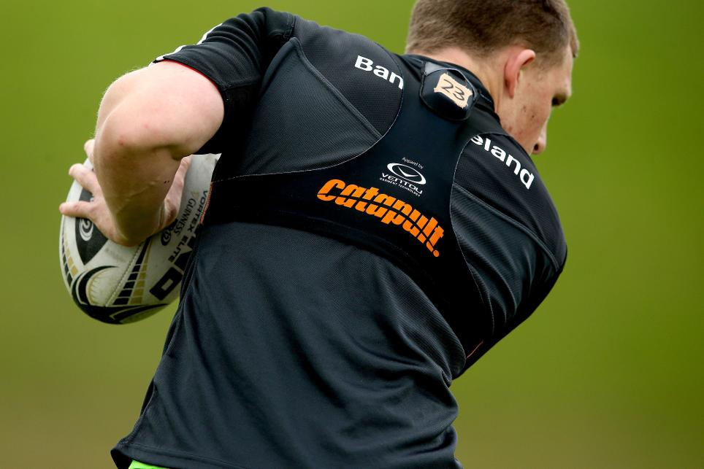
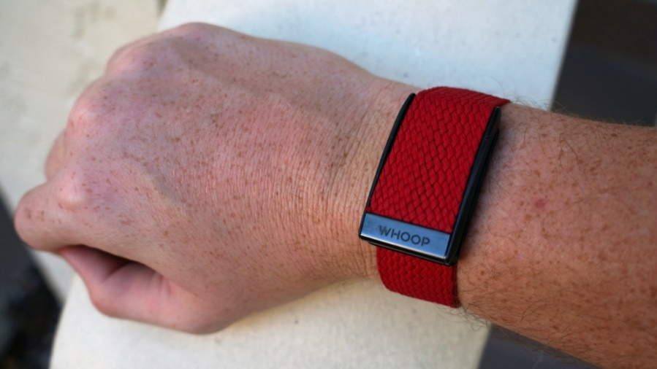
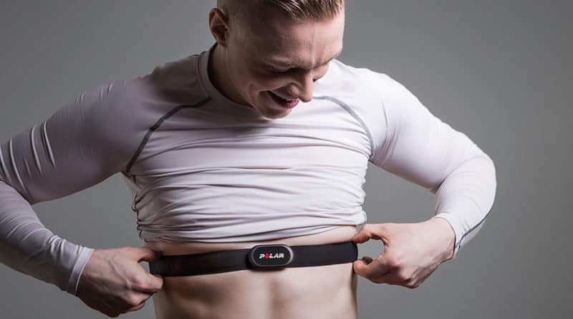
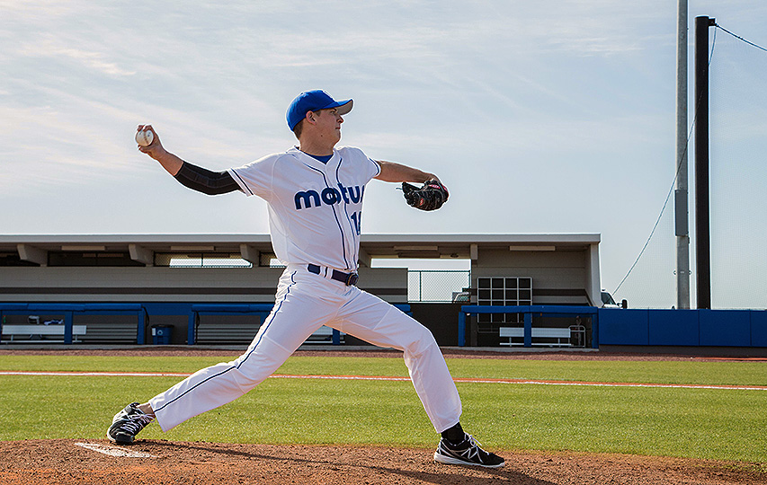
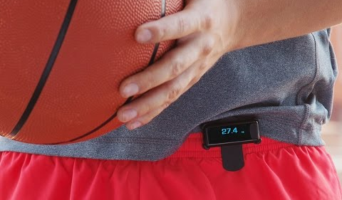
Performance Capturing Wearables

Slide 15
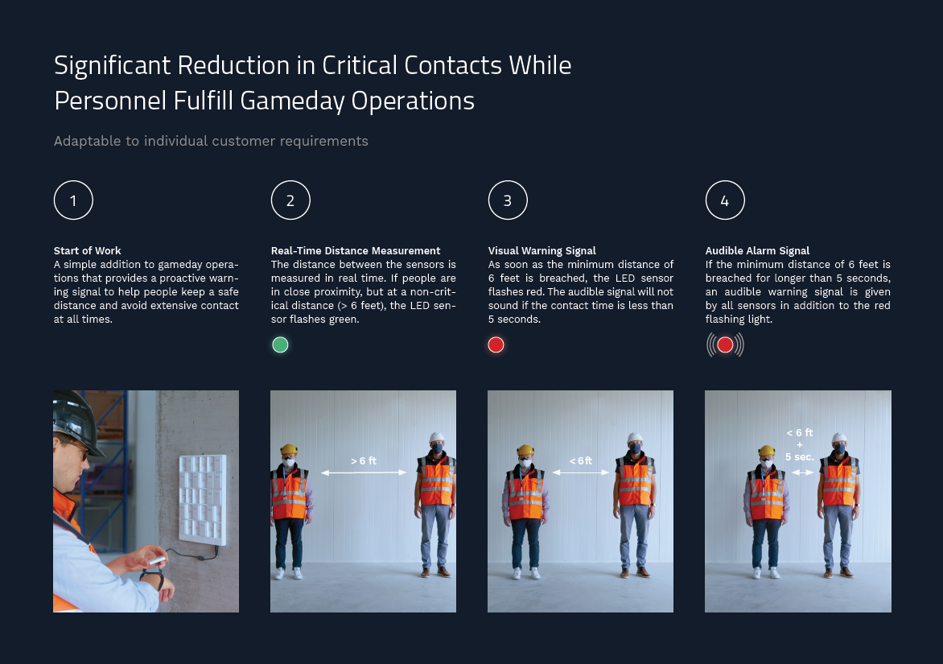
Safety Alarming Wearables

Slide 16
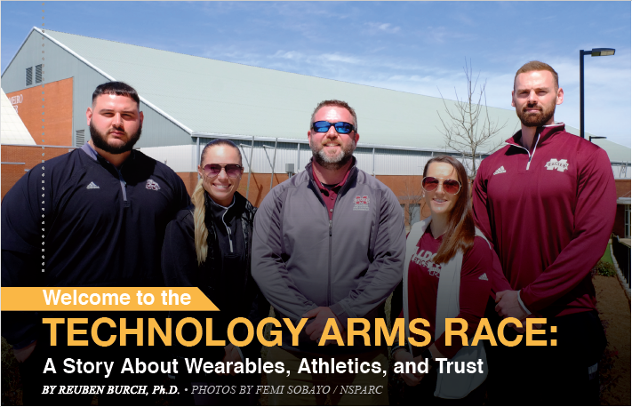
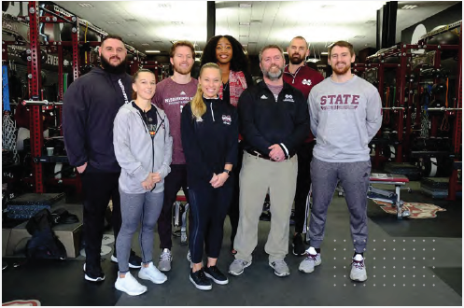
Bringing Athletics & Academics Together for Wearable Research
https://www.weringtrue.msstate.edu/athleteengineering/index.html

Slide 17
Athlete Engineering in a One Minute Video

Slide 18
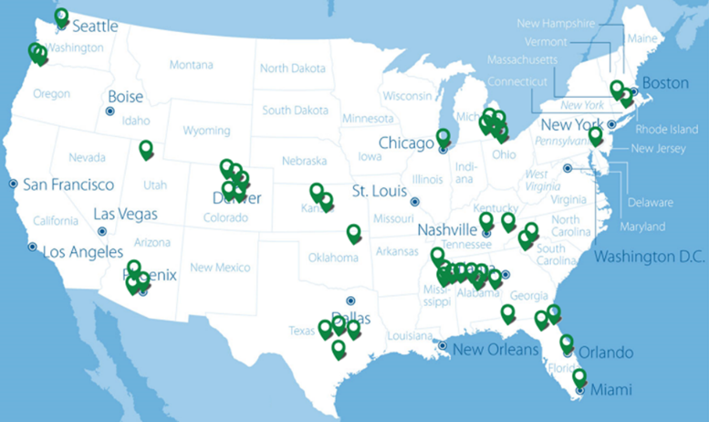
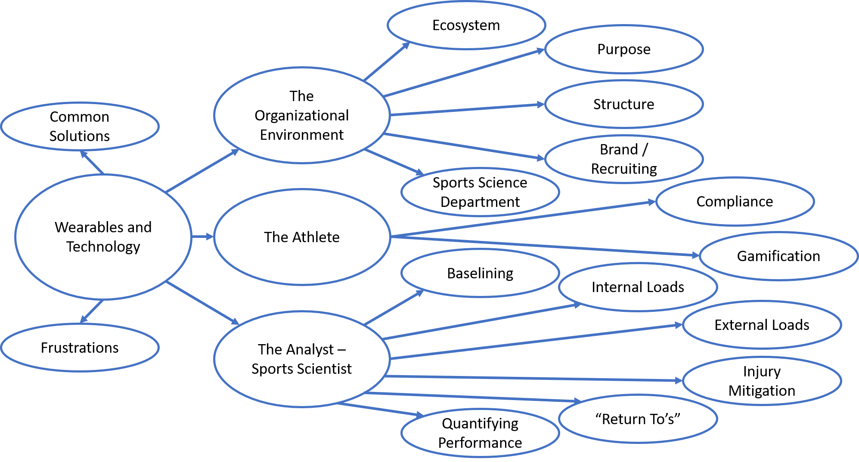
National Athletic Research Network Feedback on Technology
Conceptual map of common themes discussed during interviews by sports practitioners using data and technology to make health and safety decisions about their athletes.
Athletics Wearable Technology State of the Art Review: What 113 strength and condition coaches and athletic trainers (at 46 athletic organizations) said about technology in sports*
*Grant funded by NSF I-Corps

Slide 19
Athlete Performance Baselining & Injury “Return To’s”
Performance = The action or process of carrying out or accomplishing an action, task, or function.
Baseline = A minimum or starting point used for comparisons.
Performance Baselining = The process of learning about athlete movement as it pertains to their current state of performance and potential risk of injury.
Other important athletic truths:
Common “Return To” Threshold Assessment Points
Injuries (especially contact injuries) cannot be prevented
Data only helps to mitigate injuries by providing warnings of the potential for injury
The human body is NOT symmetrical
The more elite the athlete, the more asymmetrical they may become

Slide 20
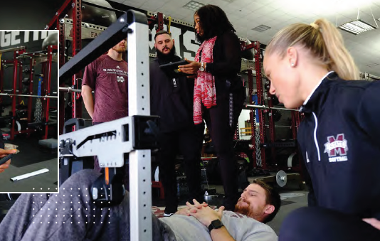
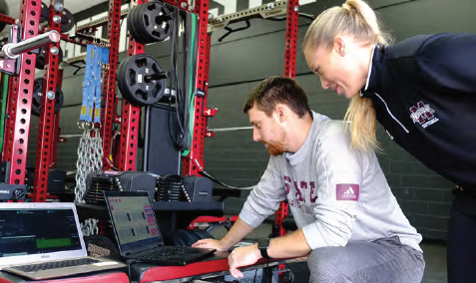
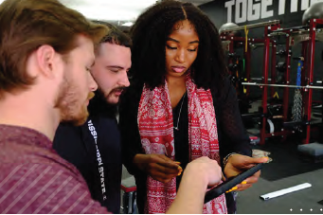
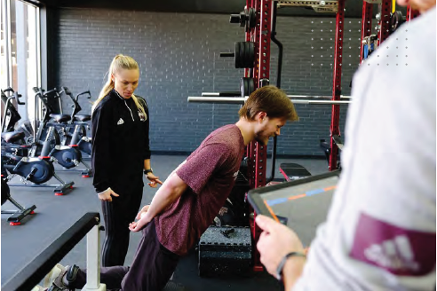
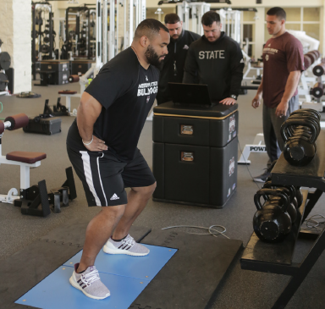
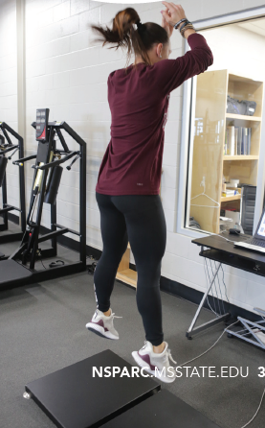
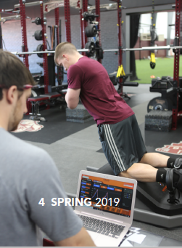
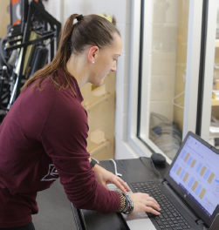
Human Performance Data Created Through Sports Training

Slide 21
Performance Capturing Wearables

Slide 22
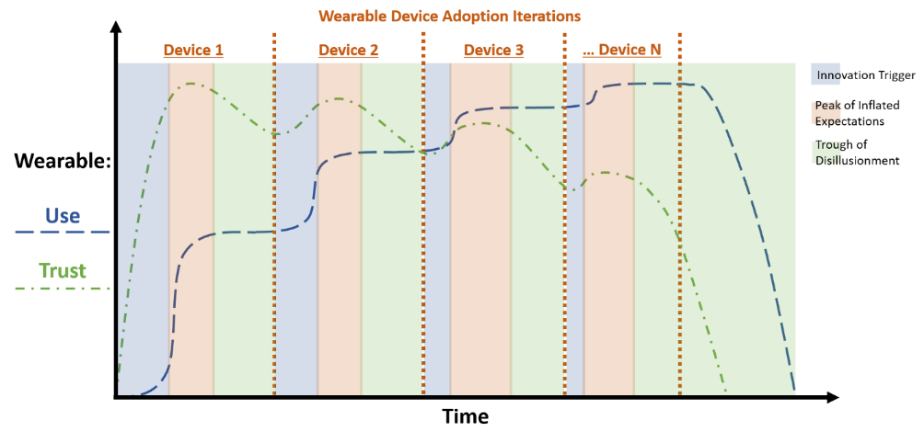
Wearables: “The data isn’t what’s needed, but that’s okay because the data scientist has no context of sports performance, and we don’t trust the technology anyway… but we buy them because everyone else does + recruiting.”

Slide 23
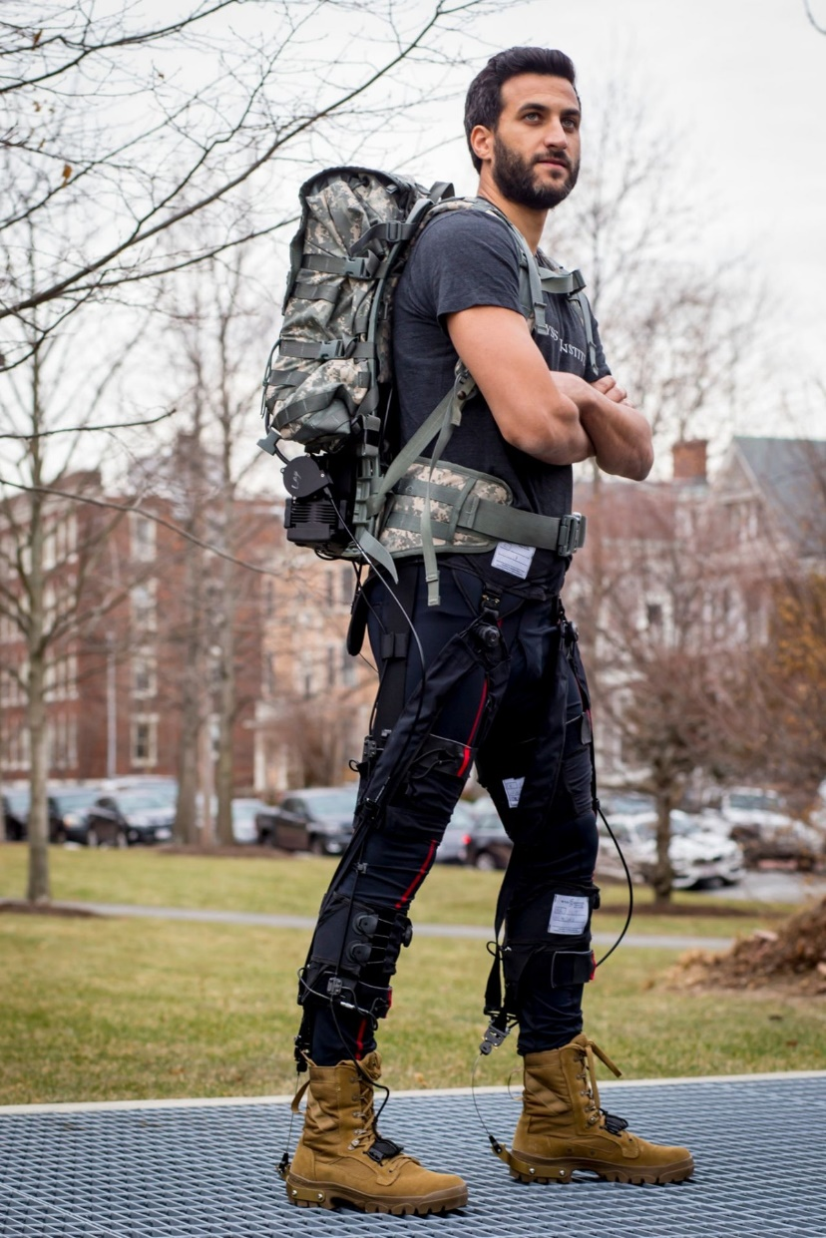
Repurposing Soft Robotic Sensors (SRS)

Slide 24
From the Ground Up

Slide 25
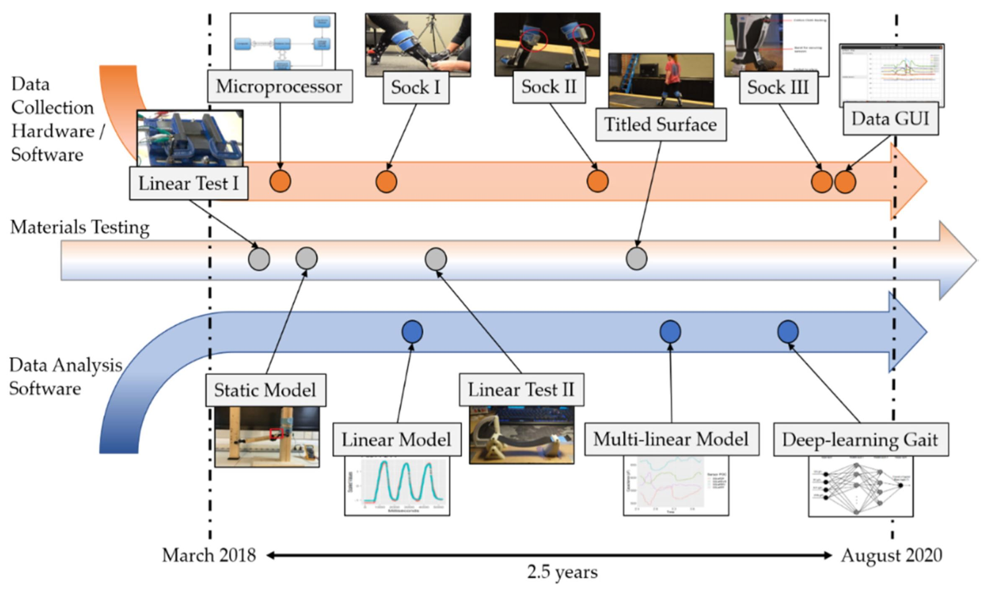
From the Ground Up

Slide 26
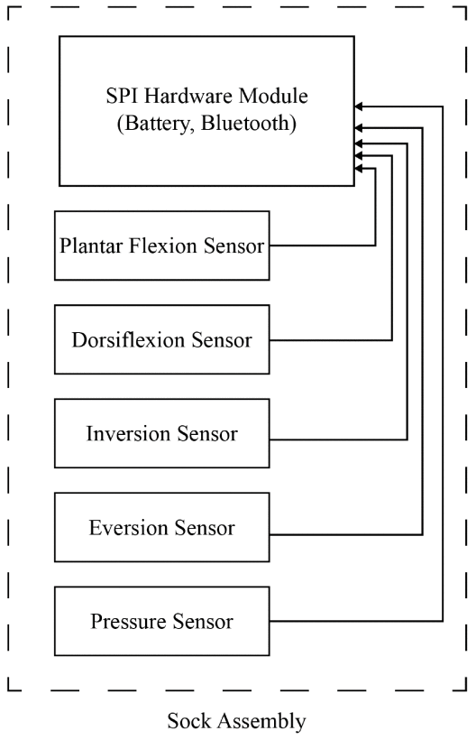
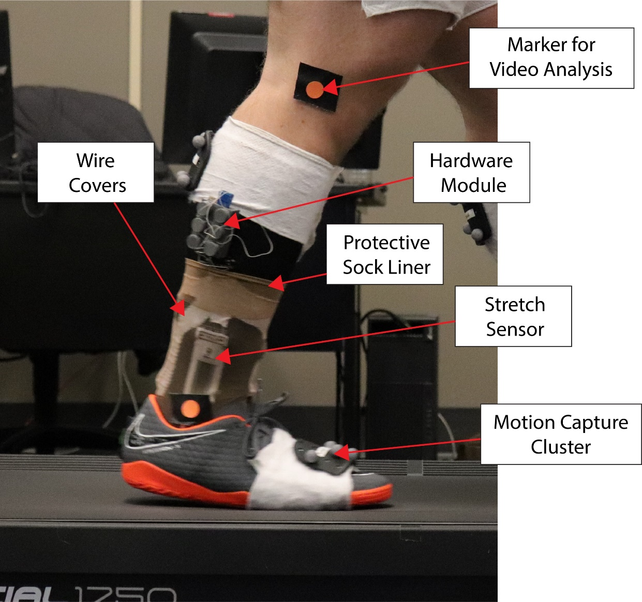
Data Collection & Sensor Validation Cycle

Slide 27
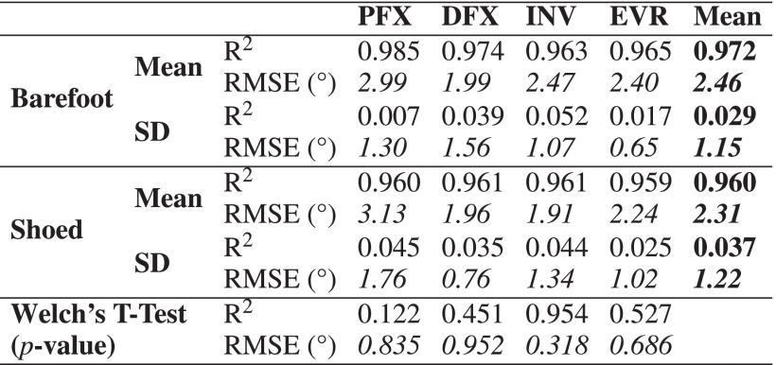
Data Analysis Learning Discovery Cycle (No Shoe VS Shoe)
 |  | Barefoot |  |  |  |  | Shoed
 |  | PFX | DFX | INV | EVR | Mean | PFX | DFX | INV | EVR | Mean
Mean | R^2 | 0.995 | 0.984 | 0.983 | 0.987 | 0.988 | 0.996 | 0.974 | 0.987 | 0.986 | 0.986
 | RMSE | 1.54 | 1.48 | 1.76 | 1.38 | 1.53 | 1.16 | 1.51 | 1.18 | 1.27 | 1.28
SD | R^2 | 0.004 | 0.027 | 0.018 | 0.009 | 0.009 | 0.002 | 0.028 | 0.011 | 0.010 | 0.010
 | RMSE | 0.54 | 1.31 | 0.54 | 0.57 | 0.55 | 0.44 | 0.72 | 0.50 | 0.42 | 0.30

Slide 28
The Study of Wearables is an Interdisciplinary Affair
Wearables are comprised of multiple components:
Sensors (any data collecting component)
Data analysis and process monitoring (statistical aggregates, data trending, artificial intelligence, machine learning, deep learning)
Wireless protocol (any radio communication, Bluetooth, WiFi, cellular, GPS)
Power supply (batteries, charging, power connectivity and sustainability)
Electronics hardware (circuit board, processor, cabling)
Casing hardware (outer casing, component connectivity)
Software (apps, GUI front end, data drill tables, security protocols, mobile or desktop)
Human work (kinesiology, biomechanics, physiology, neuromechanics, loading, readiness)
Textiles (substrates, clothing integration, fabric materials, washing, cleaning)
Ruggedization (ingress protection, drop testing, sensor and material fatiguing, MILSPEC 810G)
User acceptance (perception, implementation, proper usage, usability)
Training (education, job preparation)
Communication (coordinating with users and stakeholders)

Slide 29
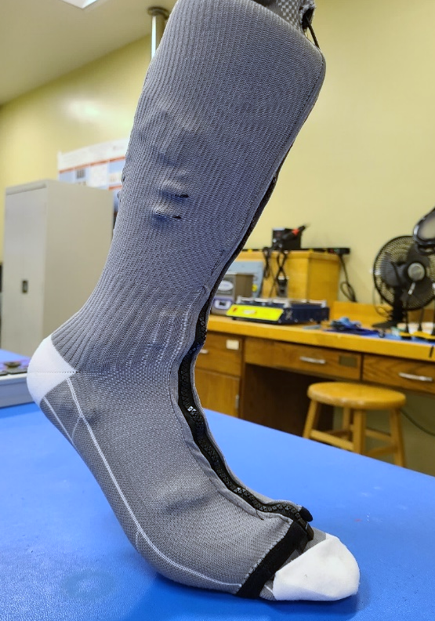
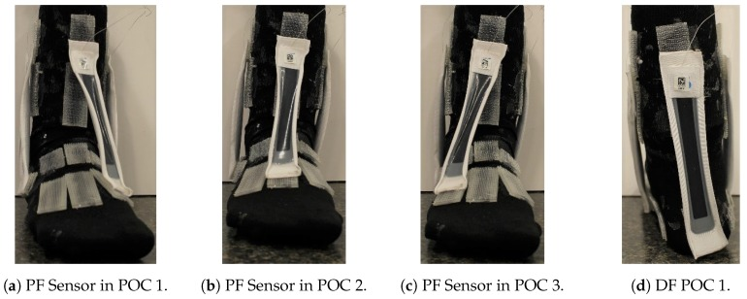
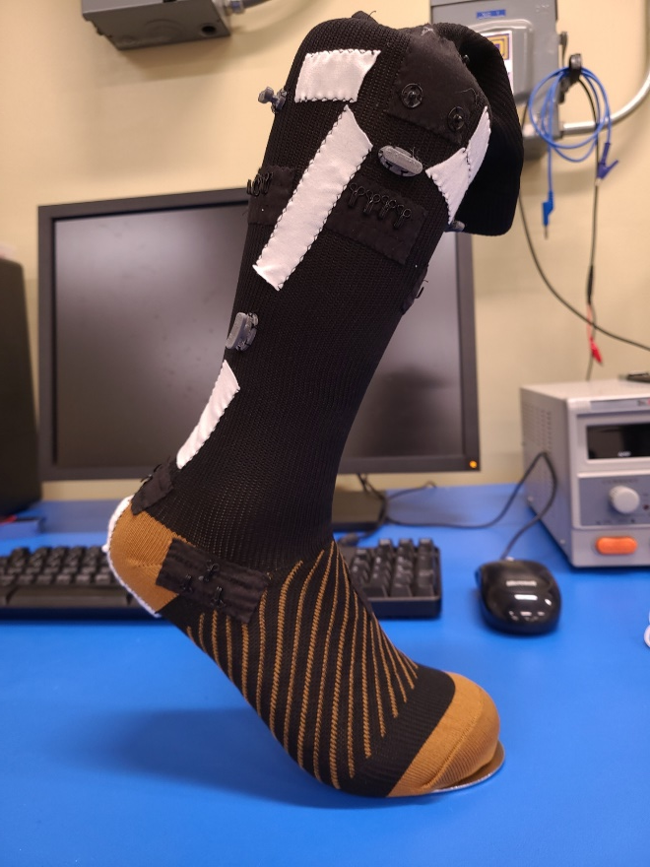
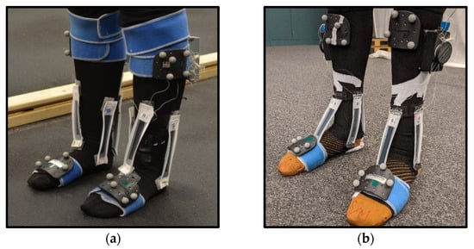
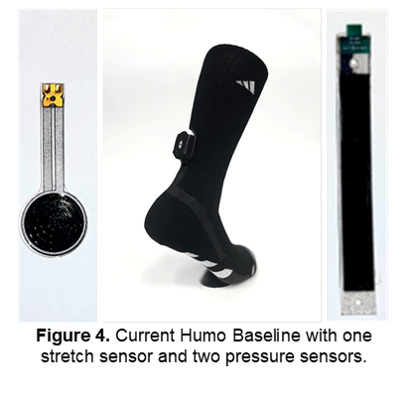
Wearable Technology Development
Thomas Edison learned 10,000 ways not to build a lightbulb…
Athlete Engineering has learned 10,000 ways not to build a wearable.

Slide 30
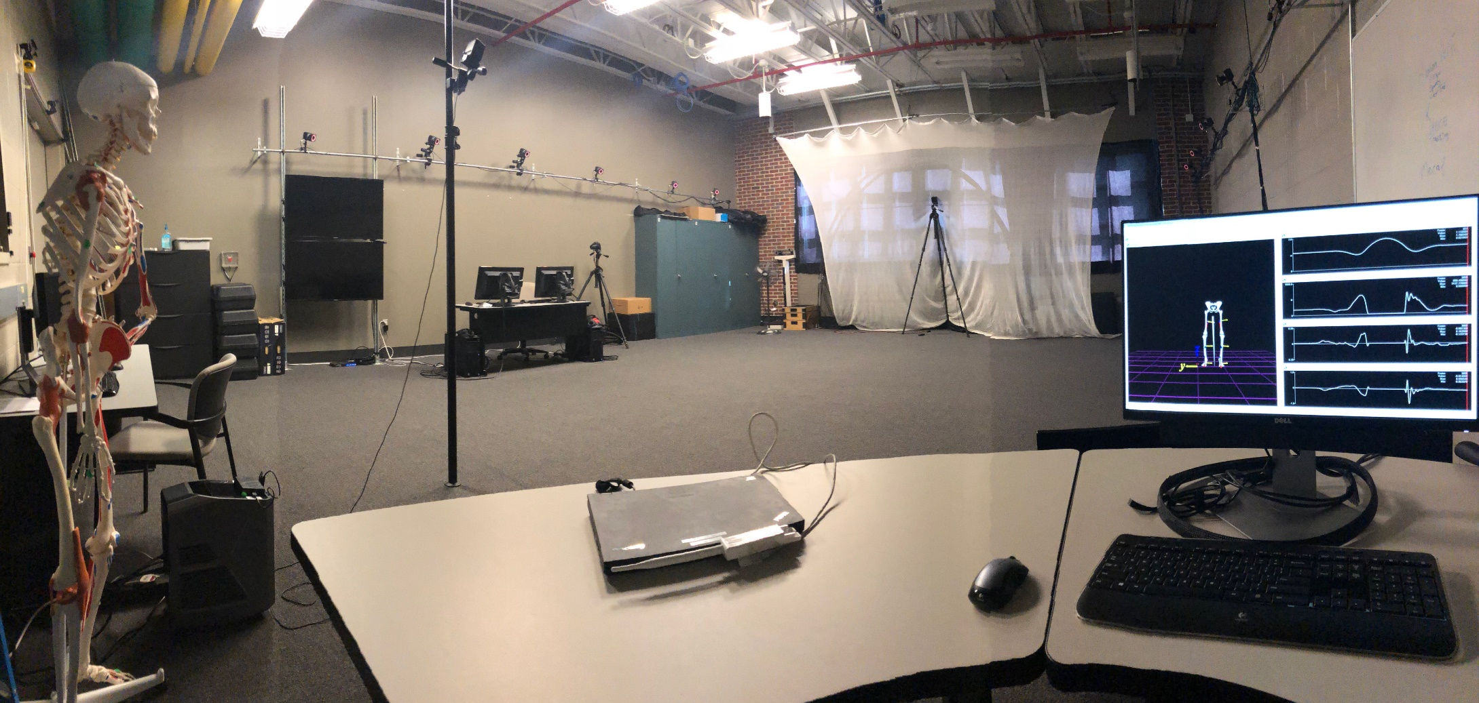
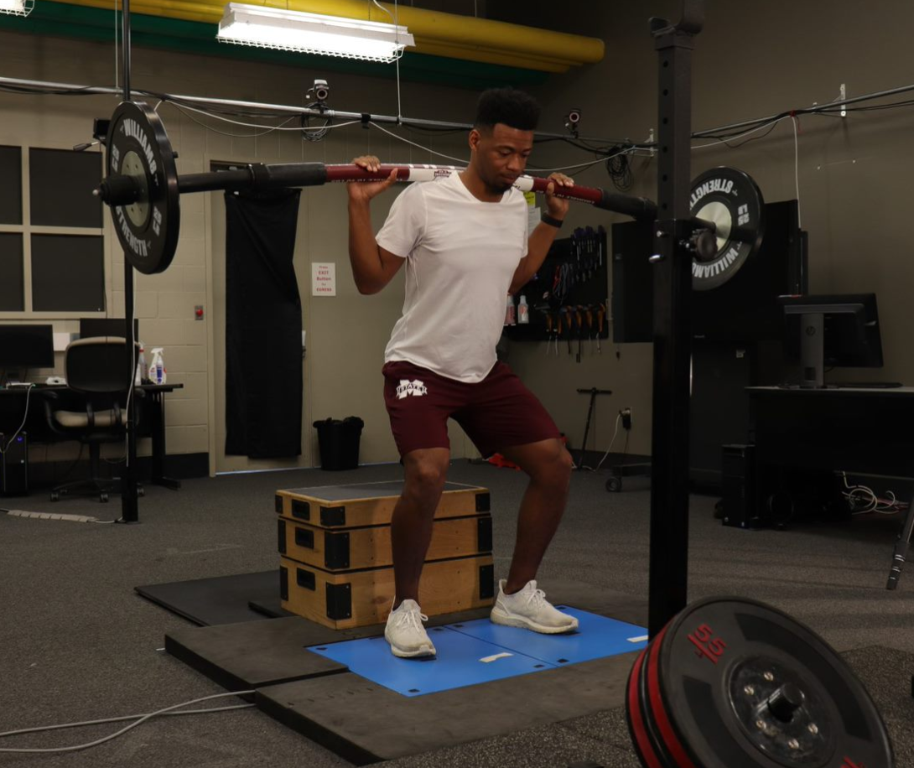
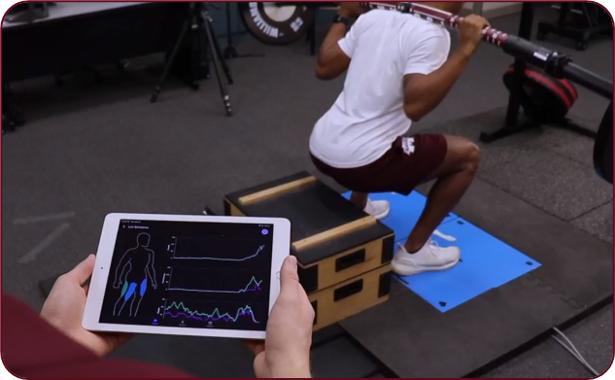
Wearable & Human Performance Technology Validation

Slide 31
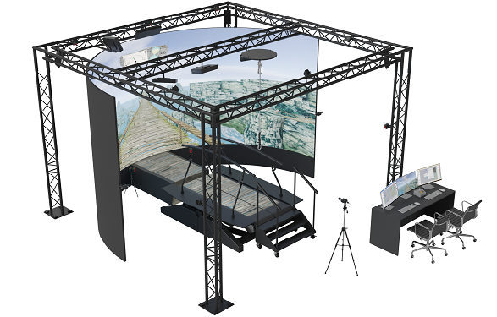
The NEW Athlete Engineering Research Lab

Slide 32
Comfort & Fit Versus Effectiveness of All Things Wearable
The design, implementation, validation, and usage of wearables and human performance technologies.
Comfort and fit versus effectiveness of all things wearable.

Slide 33
The Pilot Athlete and UPT 2.5
Three Pillars of Pilot Training
What the Air Force is doing with UPT 2.5 for pilots, is nearly identical to what professional and collegiate sports teams do for athletes.
This is the necessary level of support for elite people performing highly complex tasks.
Human
Performance
Technology
Curriculum

Slide 34
Human Performance Data Created Through Pilot Training

Slide 35
Human Performance is Merging Across Sectors
Industry Sector: What are the best programming languages to learn to manage large amounts of data
- NFL Strength Coach
Sports Sector: What is the best Athlete Management System to synchronize data from multiple wearables and performance output
- Air Force Wing Commander
Military Sector: What are the best wearable solutions to aid in conditioning assessment protocols
- Manufacturing Company Safety Engineer
Industry
Sector
Sports
Sector
Military
Sector
Advancements in Human Performance Technology & Data Science
Notes:
If you came to this summit, there’s a good chance you’re just as interested in the advances in human performance, data science, and wearable technologies as we are.
It’s an exciting time be involved in any way with human performance.
Because of things like wearables and machine learning, how we view human performance and who views human performance is much different today than 10 or even five years ago.
One of the largest changes we’ve seen is how the different sectors of work and competition have been merging.
For example:
[Walk through slide animations for the difference sectors]
[When at the convergent point]
The reason sectors have started to converge together is because these advancements in human performance technology and data science are making them more accessible to nearly anyone regardless of the work task being performed.
This overlap in the Venn diagram is where we’ve built our Athlete Engineering Research program. This is our bailiwick, the area where we perform most of our work and research.
How we designed our program so that we could have impact in all sectors was through the advice and guidance from many of the people you will meet at this conference which leads us to this panel.

Slide 36
Athlete Engineering Personas
Everyone is an athlete, and we can always make better decisions about health and safety:
Industrial Athlete: the repetitive motion task worker in manufacturing, warehousing, logistics, and other service-oriented industries.
Tactical Athlete: military personnel, the warfighter, and the emergency responder.
At-Risk Athlete: the clinical patients in rehabilitation, recovery as well as telehealth and tele-rehab.
Sports Athlete: the student and professional athletes in competition.
Nike’s Mission Statement: “… Nike founder Bill Bowerman’s state[s], “If you have a body, you are an athlete…

Slide 37
Operate Independently, Compete Collectively Mississippi

Slide 38
Athlete Engineering New Curriculum
Athlete Engineering Certificate Program:
Design & Implementation of Wearable Technology
Workplace Physiology
Intellectual Property & Patent Design
Data Science in the Sports Ecosystem
Cognitive Engineering
Human Factors Engineering
Macroergonomics
Applied Ergonomics Methods
Dr. Adam Petway
Washington
Wizards
Dr. Bill Burgos
Minnesota
Timberwolves
Notes:
Complacency is our biggest

Slide 39
Athlete Engineering Summit

Slide 40
Athlete Data Science Skills Lifecycle
Low-skill (High school/GED education only)
Equipment issue room management (technology distribution, minimal support); fitting of devices
Data collection support and manual data capture; installing and monitoring
Basic understanding of context for the data
Middle-skill (Post high school/vocational training)
Speaking the language of the stakeholder (multilingual)
Submitting, receiving, and coding survey data
Coding, cleaning, annotating and (some) validating data
Deploying an already defined method for data collection
Providing aggregate data analysis using widespread tools (MS Excel)
Using some laboratory tools and all wearable technologies
Advanced understand of context for the data
High-skill (Targeted four-year degree program)
Developing surveys and other data collection methods that are valid and repeatable
Using all laboratory tools and technologies including trouble shooting
Providing detailed data analysis methods and some more advanced Machine Learning skills
Data-driven product design and analysis cycling

Slide 41
Reuben Burch Contact Information
Email: burch@ise.misstate.edu
Office Phone: 662-325-1677
Office Location: 260i McCain Engineering Building

