Slide 1
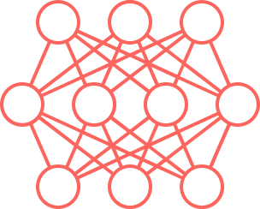
Graduate Certificate in Data Science Pedagogy
Mississippi State University

Slide 2
The Importance of Data Science
As we have heard, skills in using data are among the most important and in-demand skills for industry.
As a result, Dr. Jesse Smith of Jones College and Dr. Parisi of Mississippi State University put together the idea to incorporate data science into the community college curriculum.
With support from the Office of the Provost, MSU made an investment in putting together a certificate program to meet this need.

Slide 3
Update on the Data Science Program
Content is designed to be useful for instructors in every discipline and to community college economic and workforce development staff.
Full certificate program has been approved and is ready for enrollment now.
Spring of 2022 - Piloted a Data Science Literacy Pedagogy class with Jones College instructors.
Jones instructors provided feedback on the course to help ensure it meets instructional needs.

Slide 4
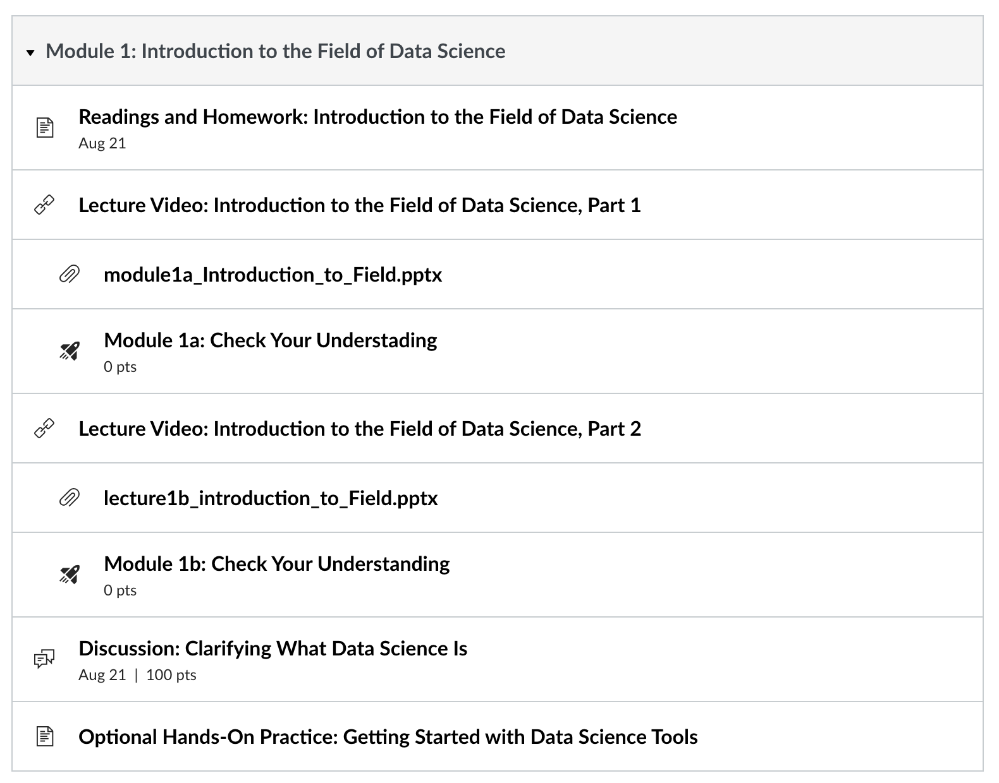
Example Canvas Module
Modified to address student feedback from the first cohort of Jones students.

Slide 5
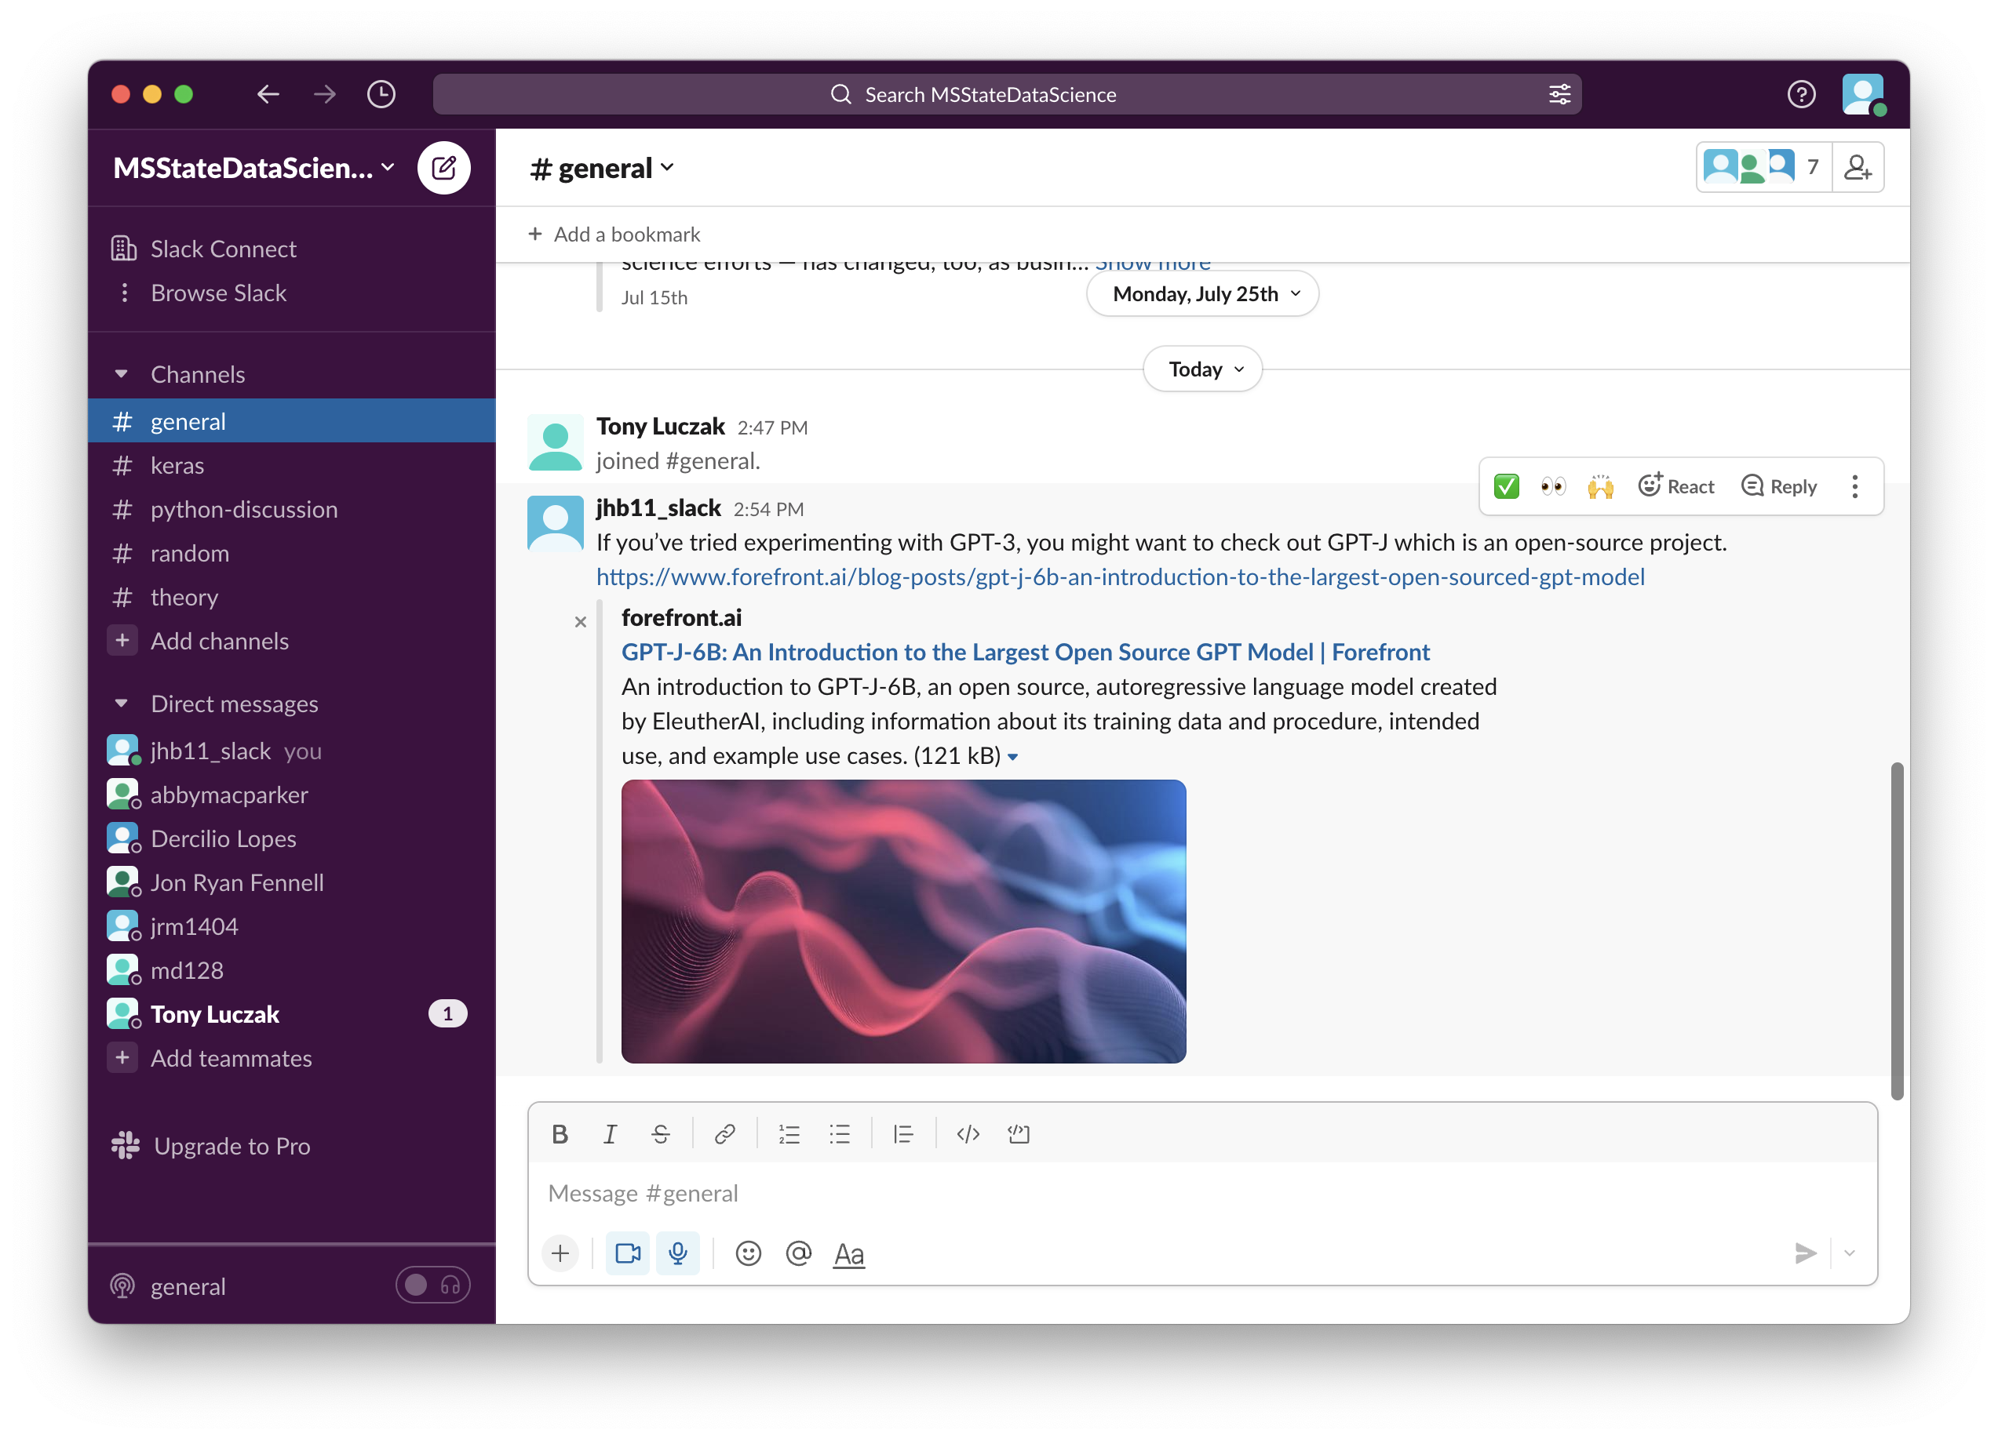
MSU Data Science Slack Workspace
Threaded discussion with peers, professors, and other data science experts at MSU.

Slide 6
Graduate Certificate in Data Science Pedagogy
12-Hour Program
Goals:
Help instructors become literate in the field of data science by understanding the role data science experts play in digital transformation; and
Teach instructors how to teach and include the practice of data science in their own classrooms, regardless of subject.
If instructor’s goal is to teach the subject of Data Science, additional coursework at MSU will help attain the proper number of hours (18) to teach a full data science course.

Slide 7
Certificate Courses
DSCI 8013 Data Science Literacy Pedagogy 1: Governance, Ethics, and Data Science Applications - General subject-matter introduction to the field of data science and data science instruction with a focus on governance, ethics, and data science applications in many fields including economic development.
DSCI 8023 Data Science Literacy Pedagogy 2: Technical Overview of Data Science Methods and Strategies - General subject-matter introduction to the field of data science and data science instruction with a focus on data science methods and practices.

Slide 8
Courses
DSCI 8033 Data Science Classroom Integration - Applying and integrating principles of data science into the context of the classroom. Topics include importance of data science across the domain; digital citizenship; career exploration; and an historical perspective on analyzing, posing, and solving problems using data.
CSE 8423 Data Science: Concepts and Practice - This course introduces the fundamental concepts of data science, covering data representation and transformation, visual data analysis, statistical modeling, tidy and relational data, functional data-flow programming, and communicating results. The course introduces the practice of data science, using standard data science tools and languages.

Slide 9
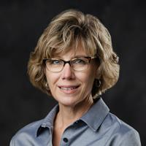
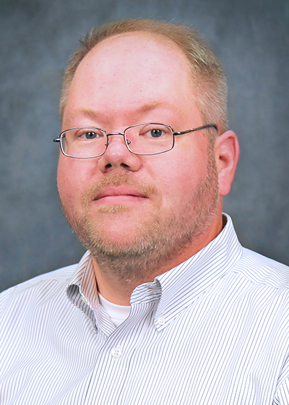
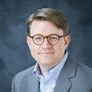
Instructors
Ed Swann
Professor
Computer Science and Engineering
Dana Franz
Professor
Dir of Academic Quality Office of Institutional Research and Effectiveness
Andy Perkins
Professor
Computer Science and Engineering
Jonathan Barlow
Assistant Teaching Professor
Associate Director
Data Science Program

Slide 10
Discounts
Because the program is important to the state, MSU has made available a discount.
15% reduction in tuition for the first 10 instructors from each community college who would like to enroll.

Slide 11
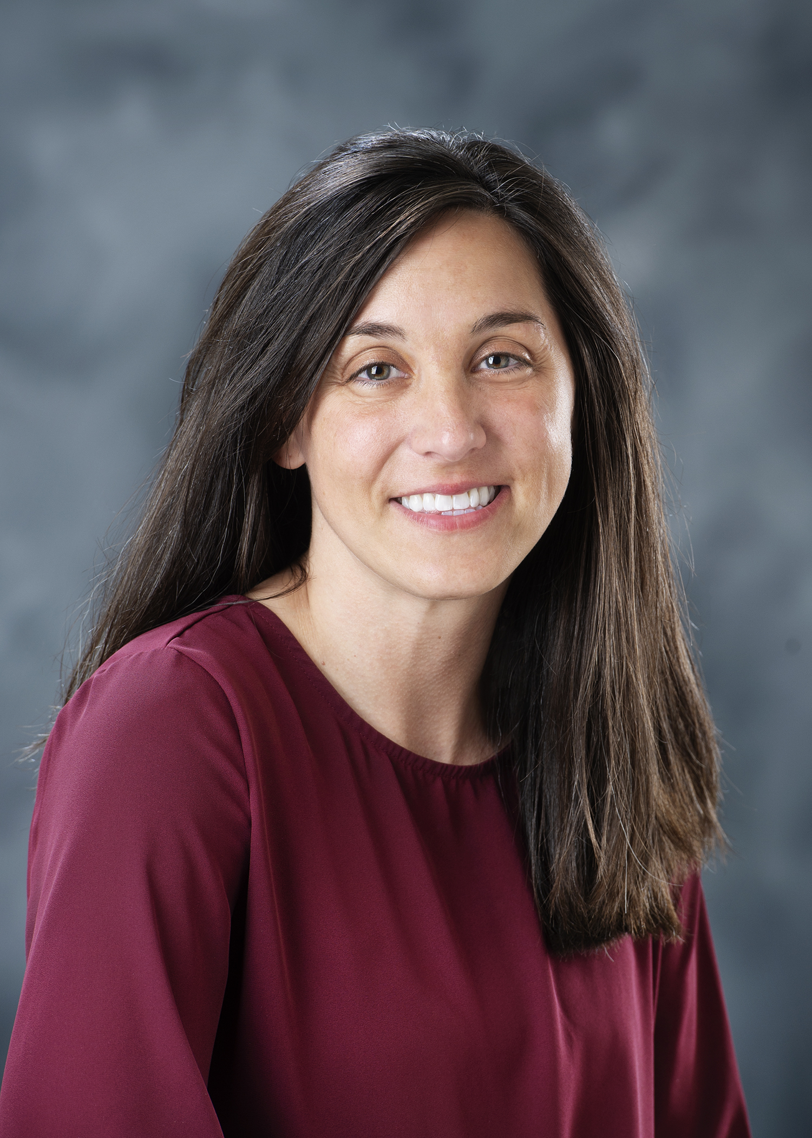
How to Get More Information or Register?
Lynn Taylor
Academic Coordinator
lynn@datascience.msstate.edu
(662)-325-3168

